Slide 1
Basic Regression Analysis with Time Series Data

Slide 2
Basic Regression Analysis with
Time Series Data
The nature of time series data
  Temporal ordering of observations; may not be arbitrarily reordered
  Typical features: serial correlation/nonindependence of observations
  How should we think about the randomness in time series data?
    The outcome of economic variables (e.g. GNP, Dow Jones) is uncertain; they should therefore be modeled as random variables
    Time series are sequences of r.v. (= stochastic processes)
    Randomness does not come from sampling from a population
    “Sample” = the one realized path of the time series out of the many possible paths the stochastic process could have taken

Slide 3
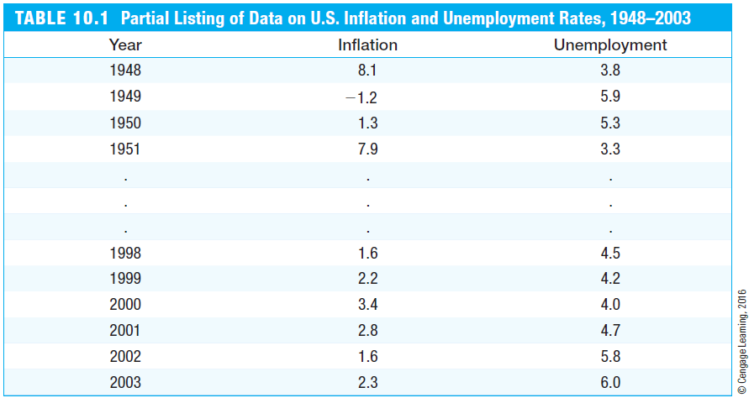
Basic Regression Analysis with
Time Series Data
Example: US inflation and unemployment rates 1948-2003
Here, there are only two time series. There may be many more variables whose paths over time are observed simultaneously.
Time series analysis focuses on modeling the dependency of a variable on its own past, and on the present and past values of other variables.

Slide 4
Basic Regression Analysis with
Time Series Data
Examples of time series regression models
Static models
  In static time series models, the current value of one variable is modeled as the result of the current values of explanatory variables
Examples for static models
There is a contemporaneous relationship between unemployment and inflation (= Phillips curve).
The current murder rate is determined by the current conviction rate, unemployment rate, and the fraction of young males in the population.

Slide 5
Basic Regression Analysis with
Time Series Data
Finite distributed lag models
  In finite distributed lag models, the explanatory variables are allowed to influence the dependent variable with a time lag
Example for a finite distributed lag model
  The fertility rate may depend on the tax value of a child, but for biological and behavioral reasons, the effect may have a lag
Children born per 1,000 women in year t
Tax exemption in year t
Tax exemption in year t - 1
Tax exemption in year t - 2

Slide 6


Basic Regression Analysis with
Time Series Data
Interpretation of the effects in finite distributed lag models
Effect of a past shock on the current value of the dep. variable
Effect of a transitory shock:
If there is a one time shock in a past period, the dep. variable will change temporarily by the amount indicated by the coefficient of the corresponding lag.
Effect of permanent shock:
If there is a permanent shock in a past period, i.e. the explanatory variable permanently increases by one unit, the effect on the dep. variable will be the cumulated effect of all relevant lags. This is a long-run effect on the dependent variable.

Slide 7
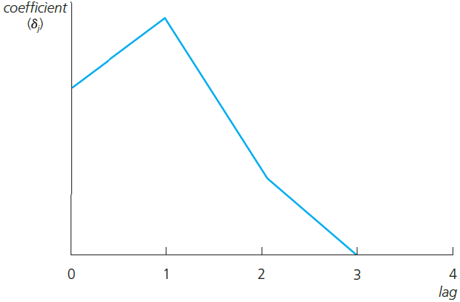
Basic Regression Analysis with
Time Series Data
Graphical illustration of lagged effects
For example, the effect is biggest after a lag of one period. After that, the effect vanishes (if the initial shock was transitory).
The long run effect of a permanent shock is the cumulated effect of all relevant lagged effects. It does not vanish (if the initial shock is a per-manent one).

Slide 8
Basic Regression Analysis with
Time Series Data
Finite sample properties of OLS under classical assumptions
Assumption TS.1 (Linear in parameters)
Assumption TS.2 (No perfect collinearity)
The time series involved obey a linear relationship. The stochastic processes y_{t}, x_{t1},…, x_{tk} are observed, the error process u_{t} is unobserved. The definition of the explanatory variables is general, e.g. they may be lags or functions of other explanatory variables.
“In the sample (and therefore in the underlying time series process), no independent variable is constant nor a perfect linear combination of the others.”

Slide 9
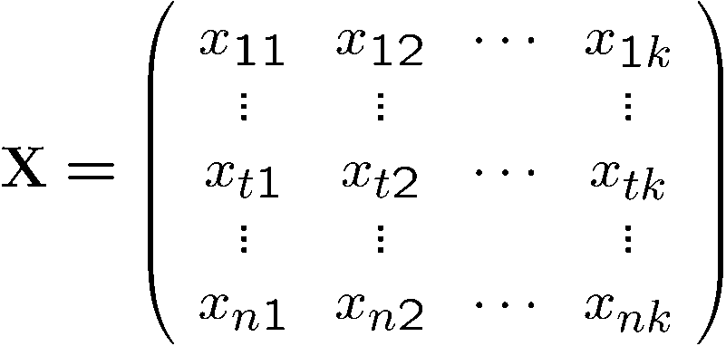

Basic Regression Analysis with
Time Series Data
Notation
Assumption TS.3 (Zero conditional mean)
This matrix collects all the information on the complete time paths of all the explanatory variables
The values of all the explanatory variables in period number t
The mean value of the unobserved factors is uncorrelated to the values of the explanatory variables in all periods

Slide 10


Basic Regression Analysis with
Time Series Data
Discussion of assumption TS.3
Strict exogeneity is stronger than contemporaneous exogeneity
  TS.3 rules out feedback from the dep. variable on future values of the explanatory variables; this is often questionable esp. if explanatory variables “adjust” to past changes in the dependent variable
  If the error term is related to past values of the explanatory variables, one should include these values as contemporaneous regressors
Exogeneity:
The mean of the error term is uncorrelated to the explanatory variables of the same period
Strict exogeneity:
The mean of the error term is uncorrelated to the values of the explanatory variables of all periods

Slide 11
Basic Regression Analysis with
Time Series Data
Theorem 10.1 (Unbiasedness of OLS)
Assumption TS.4 (Homoskedasticity)
  A sufficient condition is that the volatility of the error is independent of the explanatory variables and that it is constant over time
  In the time series context, homoskedasticity may also be easily violated, e.g. if the volatility of the dep. variable depends on regime changes
The volatility of the errors must not be related to the explanatory variables in any of the periods

Slide 12
Basic Regression Analysis with
Time Series Data
Assumption TS.5 (No serial correlation)
Discussion of assumption TS.5
  Why was such an assumption not made in the cross-sectional case?
  The assumption may easily be violated if, conditional on knowing the values of the indep. variables, omitted factors are correlated over time
  The assumption may also serve as substitute for the random sampling assumption if sampling a cross-section is not done completely randomly
  In this case, given the values of the explanatory variables, errors have to be uncorrelated across cross-sectional units (e.g. states)
Conditional on the explanatory variables, the un-observed factors must not be correlated over time

Slide 13
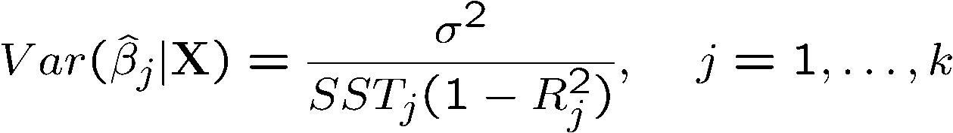
Basic Regression Analysis with
Time Series Data
Theorem 10.2 (OLS sampling variances)
Theorem 10.3 (Unbiased estimation of the error variance)
Under assumptions TS.1 – TS.5:
The same formula as in the cross-sectional case
The conditioning on the values of the explanatory variables is not easy to understand. It effectively means that, in a finite sample, one ignores the sampling variability coming from the randomness of the regressors. This kind of sampling variability will normally not be large (because of the sums).

Slide 14


Basic Regression Analysis with
Time Series Data
Theorem 10.4 (Gauss-Markov Theorem)
  Under assumptions TS.1 – TS.5, the OLS estimators have the minimal variance of all linear unbiased estimators of the regression coefficients
  This holds conditional as well as unconditional on the regressors
Assumption TS.6 (Normality)
Theorem 10.5 (Normal sampling distributions)
  Under assumptions TS.1 – TS.6, the OLS estimators have the usual nor-mal distribution (conditional on ). The usual F- and t-tests are valid.
This assumption implies TS.3 – TS.5
independently of

Slide 15
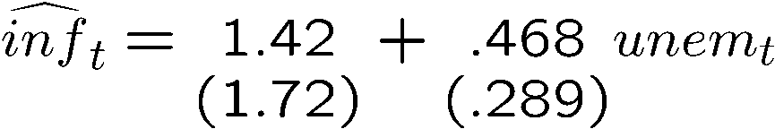
Basic Regression Analysis with
Time Series Data
Example: Static Phillips curve
Discussion of CLM assumptions
Contrary to theory, the estimated Phillips Curve does not suggest a tradeoff between inflation and unemployment
The error term contains factors such as monetary shocks, income/demand shocks, oil price shocks, supply shocks, or exchange rate shocks
TS.1:
TS.2:
A linear relationship might be restrictive, but it should be a good approximation. Perfect collinearity is not a problem as long as unemployment varies over time.

Slide 16


Basic Regression Analysis with
Time Series Data
Discussion of CLM assumptions (cont.)
TS.3:
Easily violated
For example, past unemployment shocks may lead to future demand shocks which may dampen inflation
For example, an oil price shock means more inflation and may lead to future increases in unemployment
TS.4:
Assumption is violated if monetary policy is more “nervous” in times of high unemployment
TS.5:
Assumption is violated if ex-change rate influences persist over time (they cannot be explained by unemployment)
TS.6:
Questionable

Slide 17
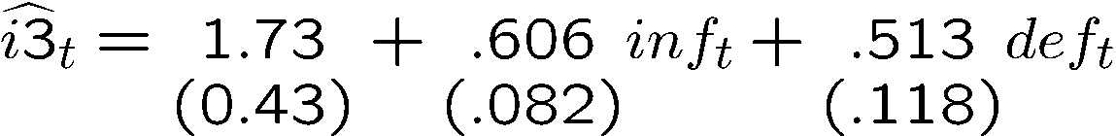
Basic Regression Analysis with
Time Series Data
Example: Effects of inflation and deficits on interest rates
Discussion of CLM assumptions
Interest rate on 3-months T-bill
Government deficit as percentage of GDP
The error term represents other factors that determine interest rates in general, e.g. business cycle effects
TS.1:
TS.2:
A linear relationship might be restrictive, but it should be a good approximation. Perfect collinearity will seldomly be a problem in practice.

Slide 18


Basic Regression Analysis with
Time Series Data
Discussion of CLM assumptions (cont.)
TS.3:
Easily violated
For example, past deficit spending may boost economic activity, which in turn may lead to general interest rate rises
For example, unobserved demand shocks may increase interest rates and lead to higher inflation in future periods
Assumption is violated if higher deficits lead to more uncertainty about state finances and possibly more abrupt rate changes
TS.4:
TS.5:
Assumption is violated if business cylce effects persist across years (and they cannot be completely accounted for by inflation and the evolution of deficits)
TS.6:
Questionable

Slide 19

Basic Regression Analysis with
Time Series Data
Using dummy explanatory variables in time series
Interpretation
  During World War II, the fertility rate was temporarily lower
  It has been permanently lower since the introduction of the pill in 1963
Children born per 1,000 women in year t
Tax exemption in year t
Dummy for World War II years (1941-45)
Dummy for availabity of con-traceptive pill (1963-present)

Slide 20
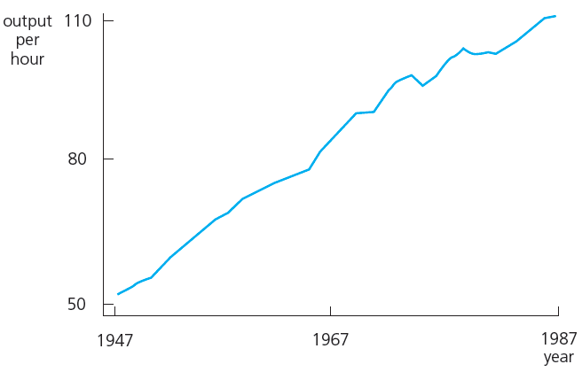
Basic Regression Analysis with
Time Series Data
Time series with trends
Example for a time series with a linear upward trend

Slide 21



Basic Regression Analysis with
Time Series Data
Modelling a linear time trend
Modelling an exponential time trend
Abstracting from random deviations, the dependent variable increases by a constant amount per time unit
Alternatively, the expected value of the dependent variable is a linear function of time
Abstracting from random deviations, the dependent vari-able increases by a constant percentage per time unit

Slide 22
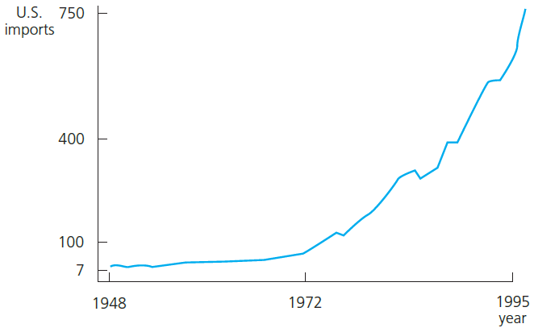
Basic Regression Analysis with
Time Series Data
Example for a time series with an exponential trend
Abstracting from random deviations, the time series has a constant growth rate

Slide 23
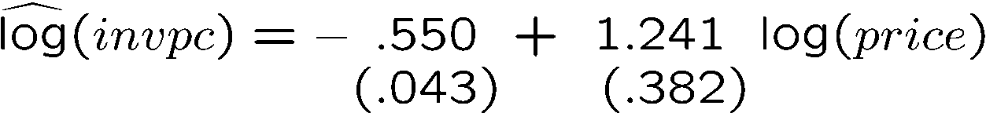
Basic Regression Analysis with
Time Series Data
Using trending variables in regression analysis
  If trending variables are regressed on each other, a spurious re- lationship may arise if the variables are driven by a common trend
  In this case, it is important to include a trend in the regression
Example: Housing investment and prices
Per capita housing investment
Housing price index
It looks as if investment and prices are positively related

Slide 24

Basic Regression Analysis with
Time Series Data
Example: Housing investment and prices (cont.)
When should a trend be included?
  If the dependent variable displays an obvious trending behaviour
  If both the dependent and some independent variables have trends
  If only some of the independent variables have trends; their effect on the dep. var. may only be visible after a trend has been substracted
There is no significant relationship between price and investment anymore

Slide 25
Basic Regression Analysis with
Time Series Data
A detrending interpretation of regressions with a time trend
  It turns out that the OLS coefficients in a regression including a trend are the same as the coefficients in a regression without a trend but where all the variables have been detrended before the regression
  This follows from the general interpretation of multiple regressions
Computing R-squared when the dependent variable is trending
  Due to the trend, the variance of the dep. var. will be overstated
  It is better to first detrend the dep. var. and then run the regression on all the indep. variables (plus a trend if they are trending as well)
  The R-squared of this regression is a more adequate measure of fit

Slide 26
Basic Regression Analysis with
Time Series Data
Modelling seasonality in time series
A simple method is to include a set of seasonal dummies:
Similar remarks apply as in the case of deterministic time trends
  The regression coefficients on the explanatory variables can be seen as the result of first deseasonalizing the dep. and the explanat. variables
  An R-squared that is based on first deseasonalizing the dep. var. may better reflect the explanatory power of the explanatory variables
= 1 if obs. from december
= 0 otherwise

